Slide 1
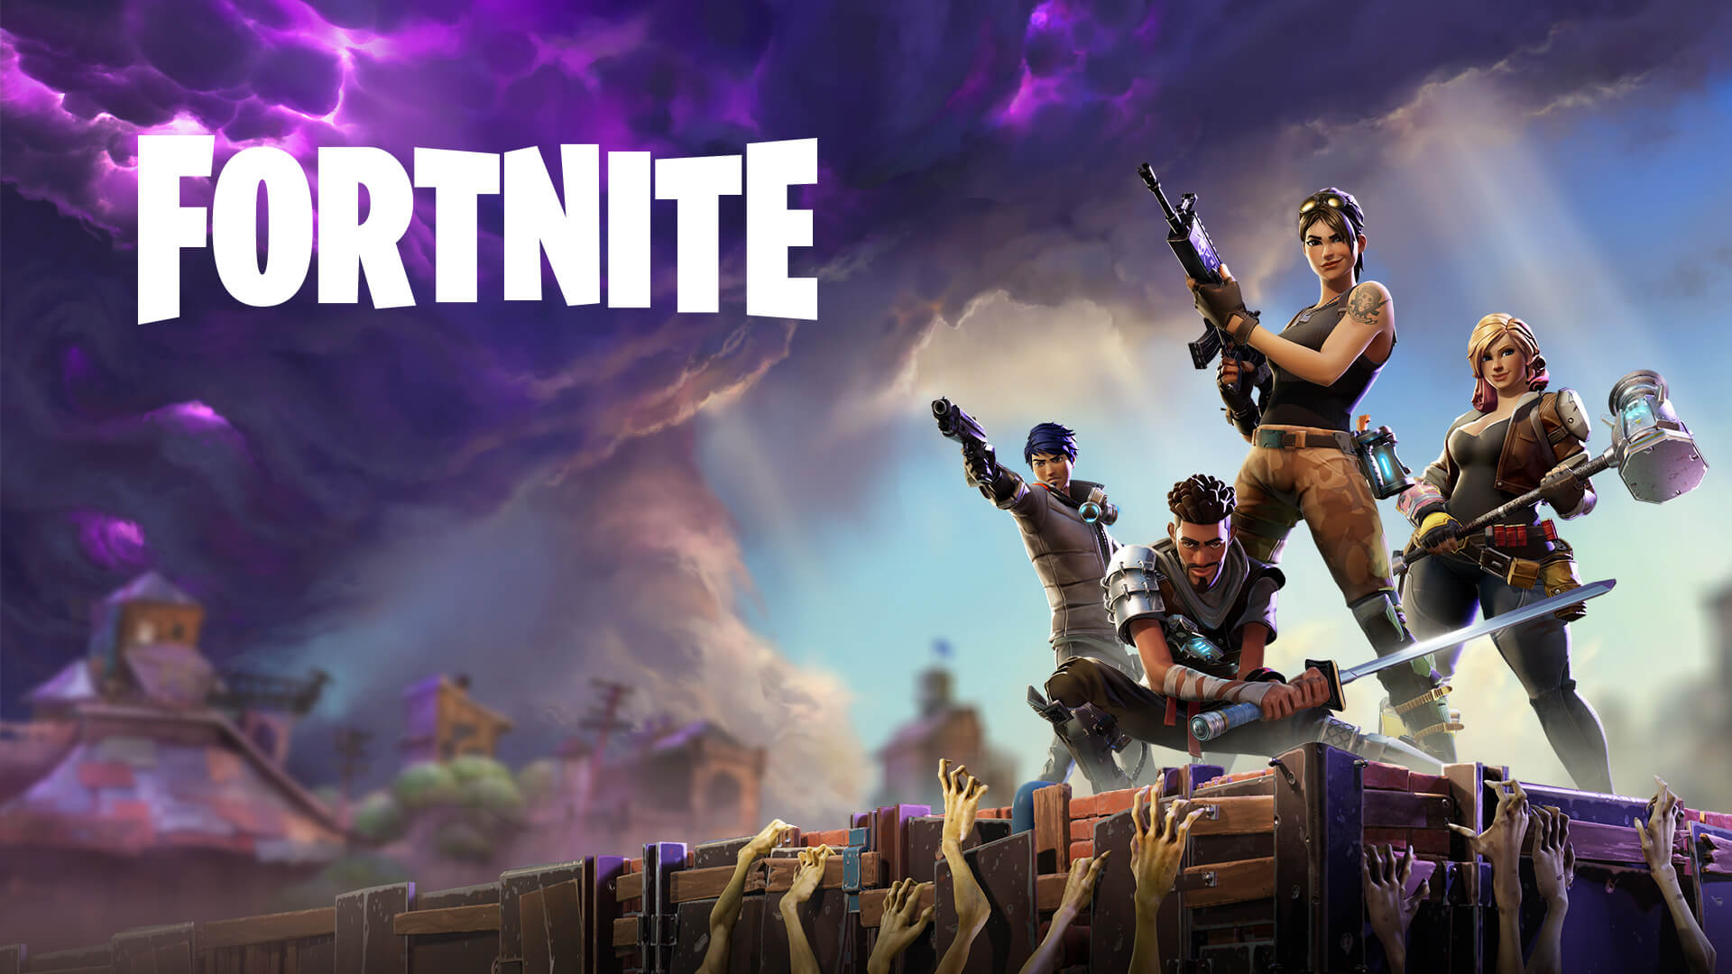
Programing in video games
Keresztúri Péter
Github: Plonee

Slide 2
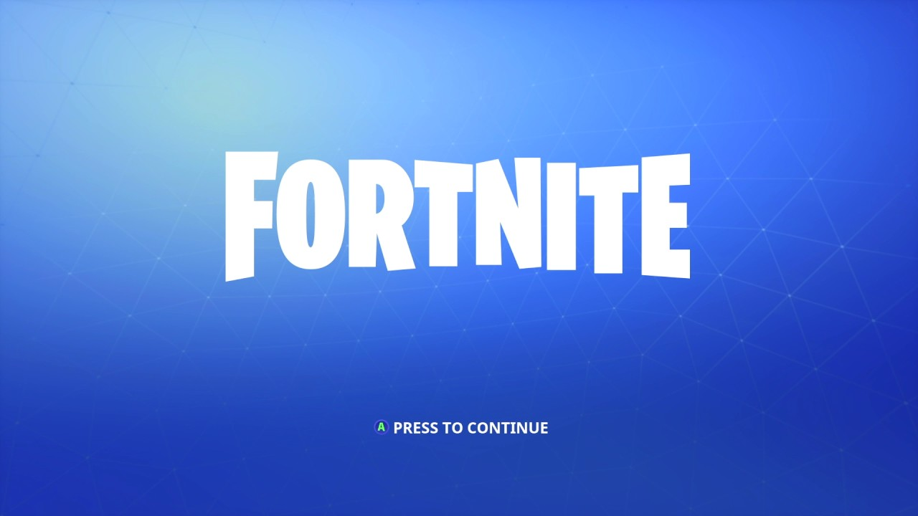
Loading brief overview…
Engine
Graphics
Combat

Slide 3

Fortnite
Published by Epic Games (how ironic…)
Battle Royal, but Pubg is way better
Looting, hiding, shooting, building
Y U do dis Mark?

Slide 4
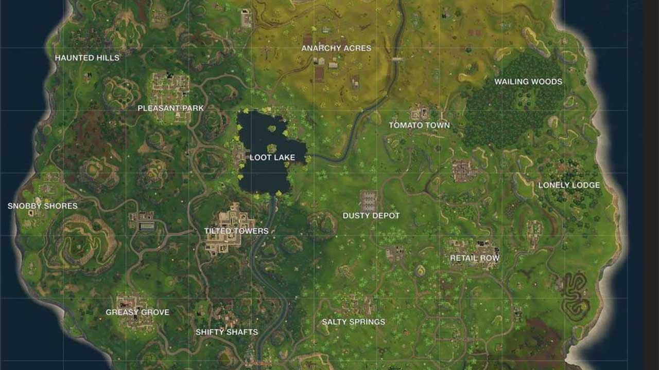

Slide 5

Engine
Framework for development
Graphics, audio, logic
Physics, AI, networking, optimalization

Slide 6
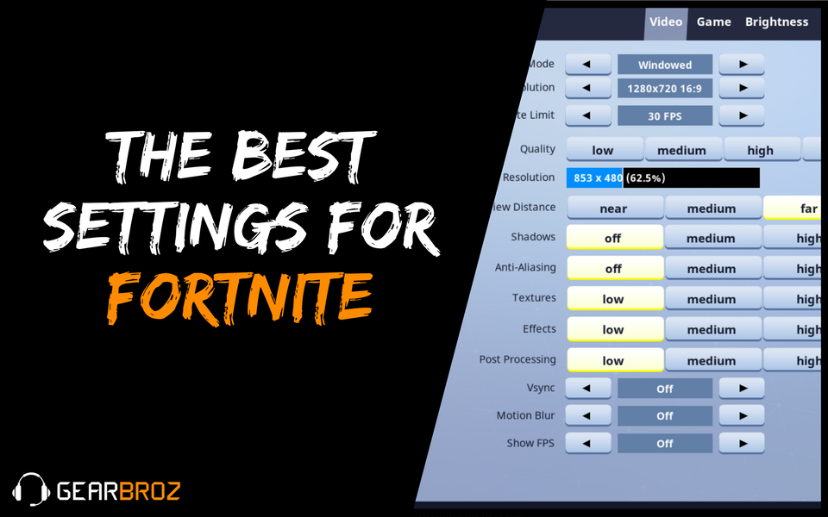

Slide 7
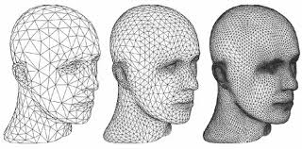
Graphics
Polygons
Character models
Movements
Motion capture

Slide 8
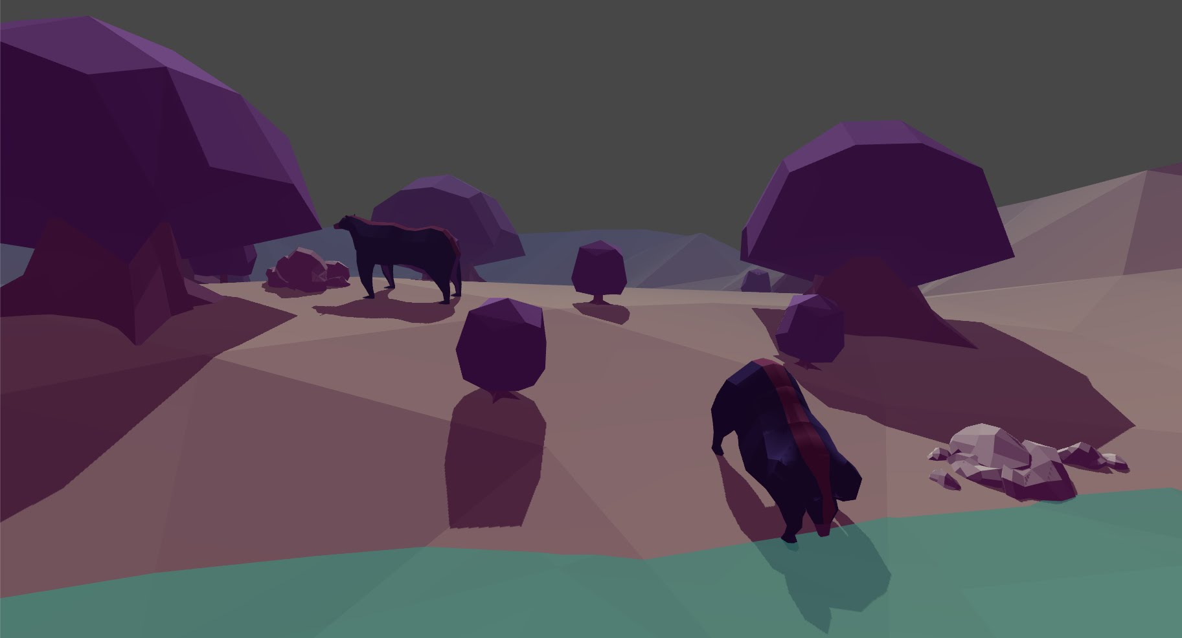

Slide 9
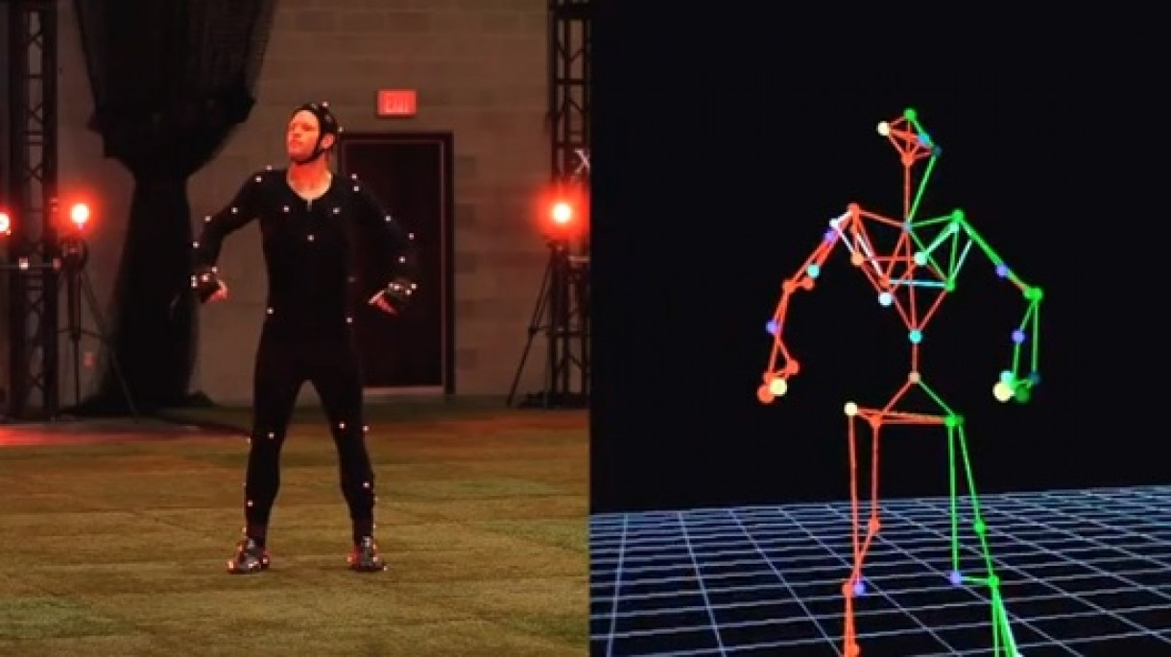

Slide 10
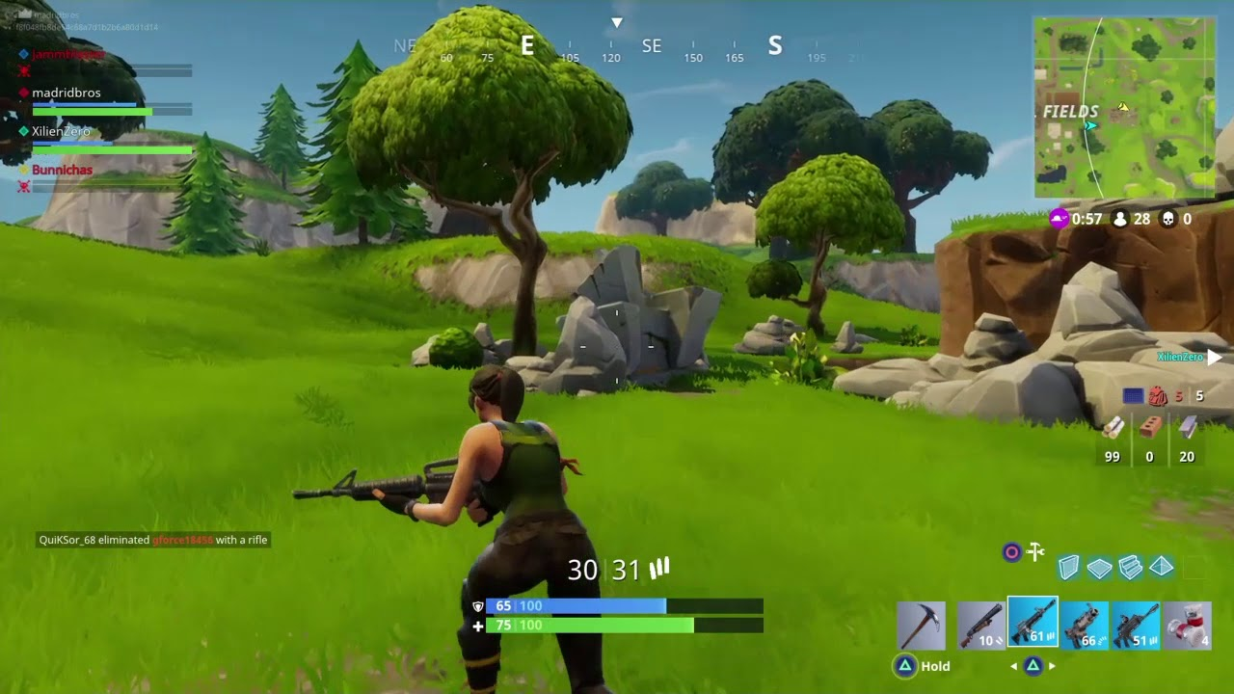

Slide 11
Combat
Targeting
Hitbox
Weapon damage
Dmg influence (random numbers, armor, shield)

Slide 12
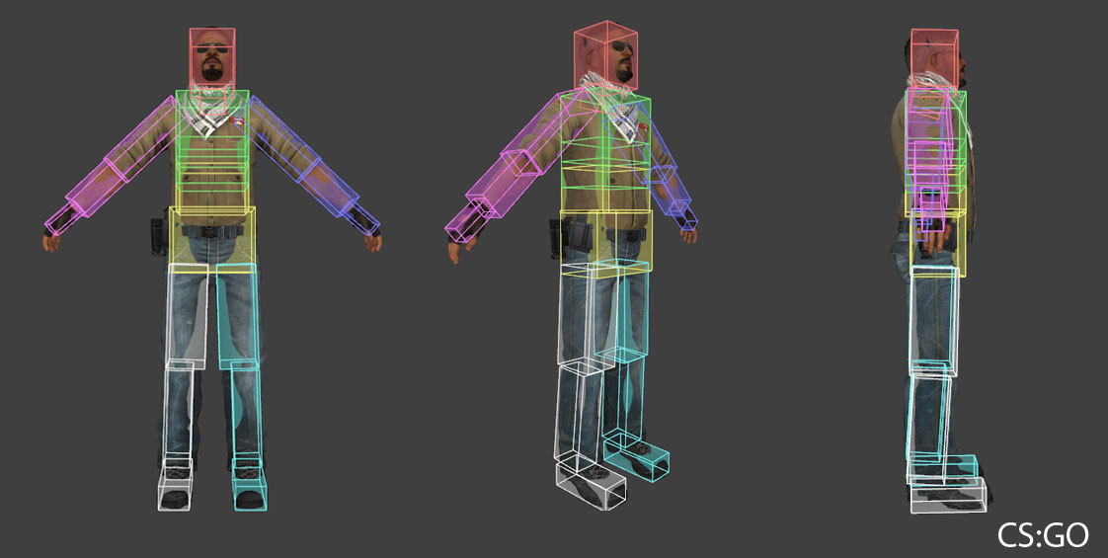

Slide 13
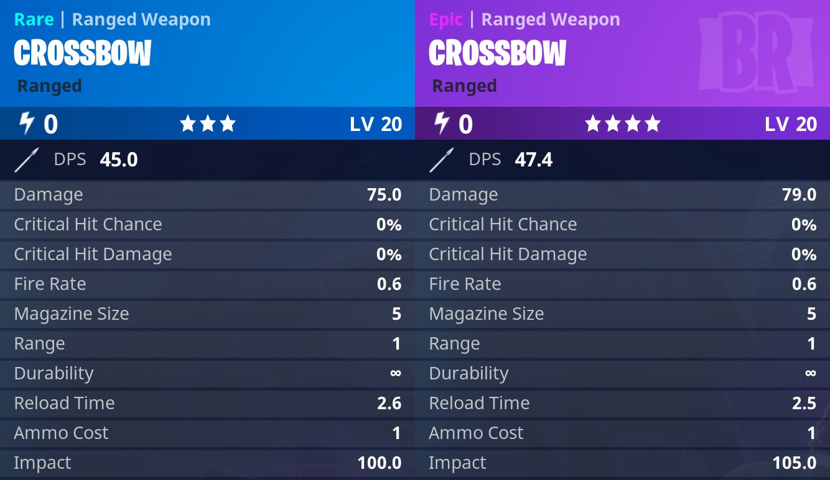

Slide 14
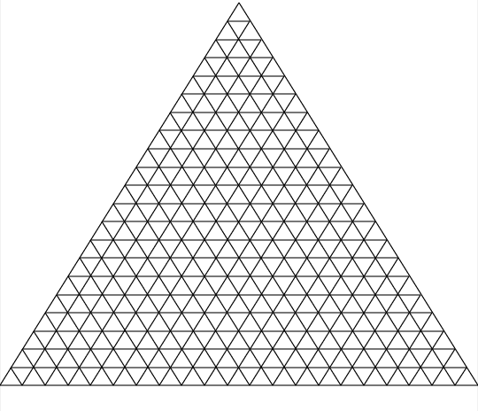
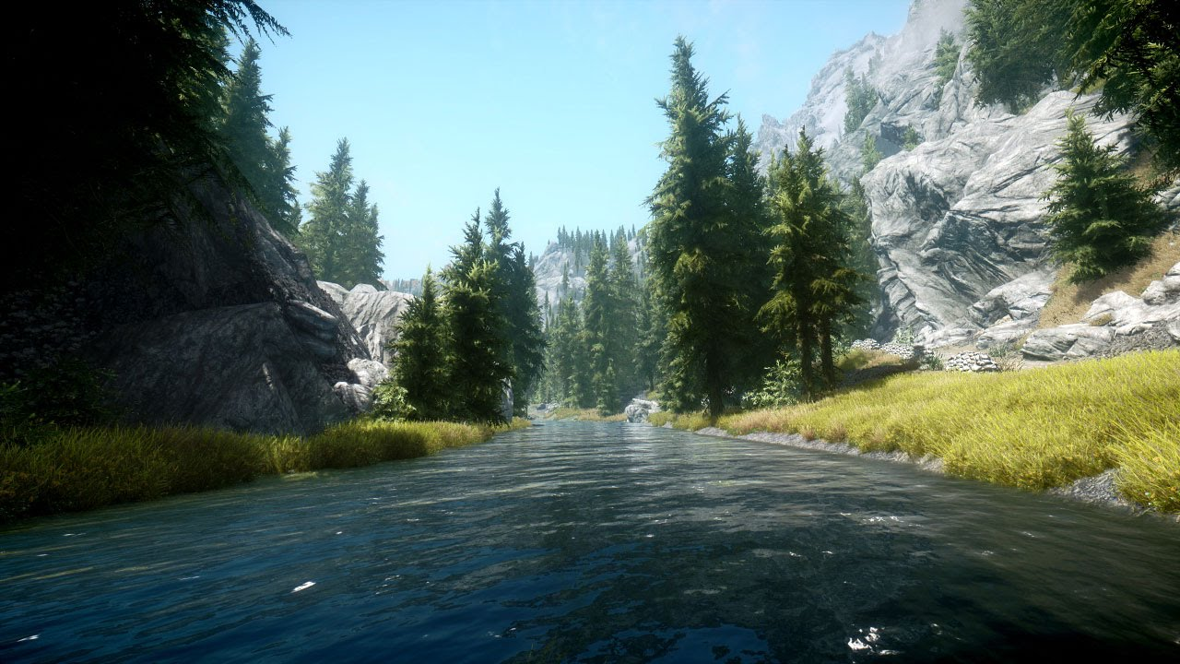
Conclusion
Wonder of technology
Hard work
Dedication
Achieve/create almost anything

Slide 15
